Slide 1
GREATER BERBERA
FROM NEIGHBOURHOOD TO NATION
A transformation that begins with a promenade and ends with a programme.
01
02
03
04
05
Town
Beautification
Urban
Structure
Corridor
Infrastructure
Economic
Engine
DFI
Programme
Pre-Feasibility Level · October 2026 · Berbera Physical Planning Team
🌐 berbera.dev

Slide 2
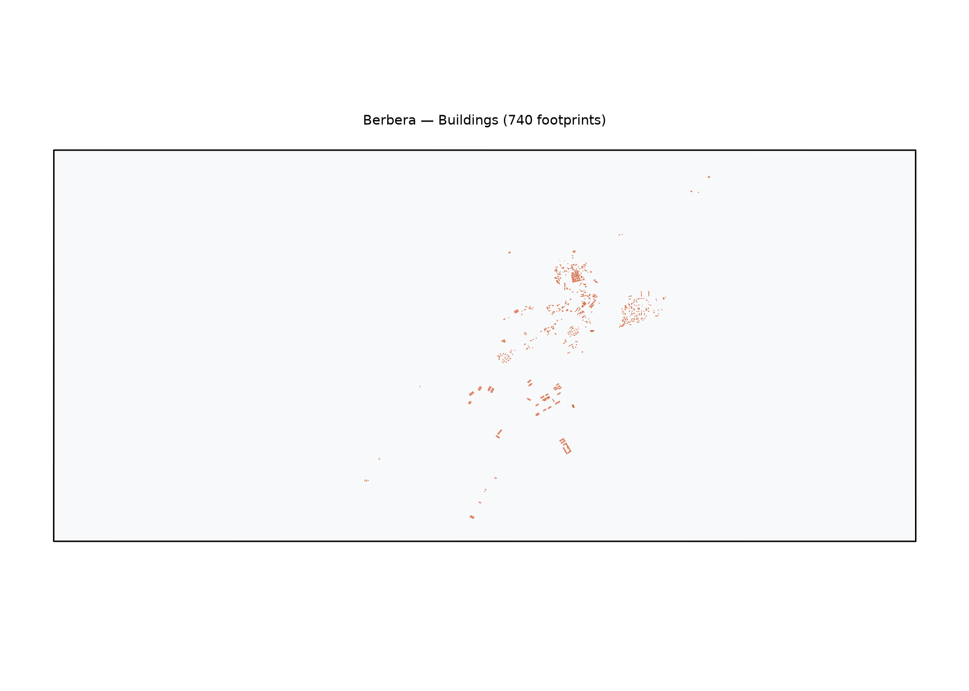
Berbera Today
01 TOWN TODAY
A coastal town of 240,000 — with untapped potential
Population
Water supply
The starting point — and the opportunity
240,000
(2026 est.)
Intermittent
6–10 hrs/day
Berbera has a functioning port, a historic Old Town, and a loyal population.
The Gulf of Aden coastline is one of the most beautiful in the Horn of Africa — undeveloped.
The gaps are infrastructure gaps — not cultural or social ones.
Citizens are already building. They need a framework to build within.
Beautification is not cosmetic. It signals intent, builds pride,
and creates the conditions for private investment to follow.
This presentation begins with what can be seen in three years,
and ends with what can be built in thirty.
450,000 by 2040 at current growth
No reticulated network, trucked water USD 12/m³
Power
Roads
30–50%
coverage
18 km
paved
Diesel generators; load-shedding daily
Majority unpaved, no storm drainage
Wastewater
Urban form
Open
drainage
Organic
growth
No sewerage; coastal pollution risk
No enforced zoning, informal settlement expanding

Slide 3
Immediate Urban Beautification
01 BEAUTIFICATION
Years 1–3: visible, affordable, transformative
WATERFRONT PROMENADE
USD 4.2M
OLD TOWN REGENERATION
USD 3.1M
3.2 km · Gulf of Aden seafront
Historic quarter · 28 ha core
Paved pedestrian boardwalk
Shade structures + seating
Fishing jetty upgrades
Night lighting (solar)
Planted coastal buffer
Heritage facade restoration
Cobblestone laneways
Pedestrianised market street
Signage + wayfinding
Public art programme
PUBLIC SQUARES & PARKS
USD 2.6M
STREET TREE PROGRAMME
USD 1.8M
7 neighbourhood squares
14 primary streets
Hard + soft landscaping
Children's play equipment
Covered market upgrades
Berbera Central Square (flagship)
Sport courts × 3
6,000 shade trees (neem, acacia)
Raised tree pits + irrigation
Median planting on main roads
Roundabout landscaping
Community nursery (50 jobs)
Total immediate beautification programme: USD 20.9M · Implementation: 18–36 months · Jobs during construction: 1,200
STREET LIGHTING
USD 5.8M
COASTAL CLEAN-UP & DRAINAGE
USD 3.4M
Full town coverage
Storm drainage + waste
2,400 solar LED streetlights
Old Town heritage lanterns
100% renewable — zero cost/yr
Safety on port access roads
Phased 18-month installation
Storm drain lining: 22 km
Coastal waste collection
Shoreline revegetation
4 community recycling hubs
Beach maintenance programme

Slide 4
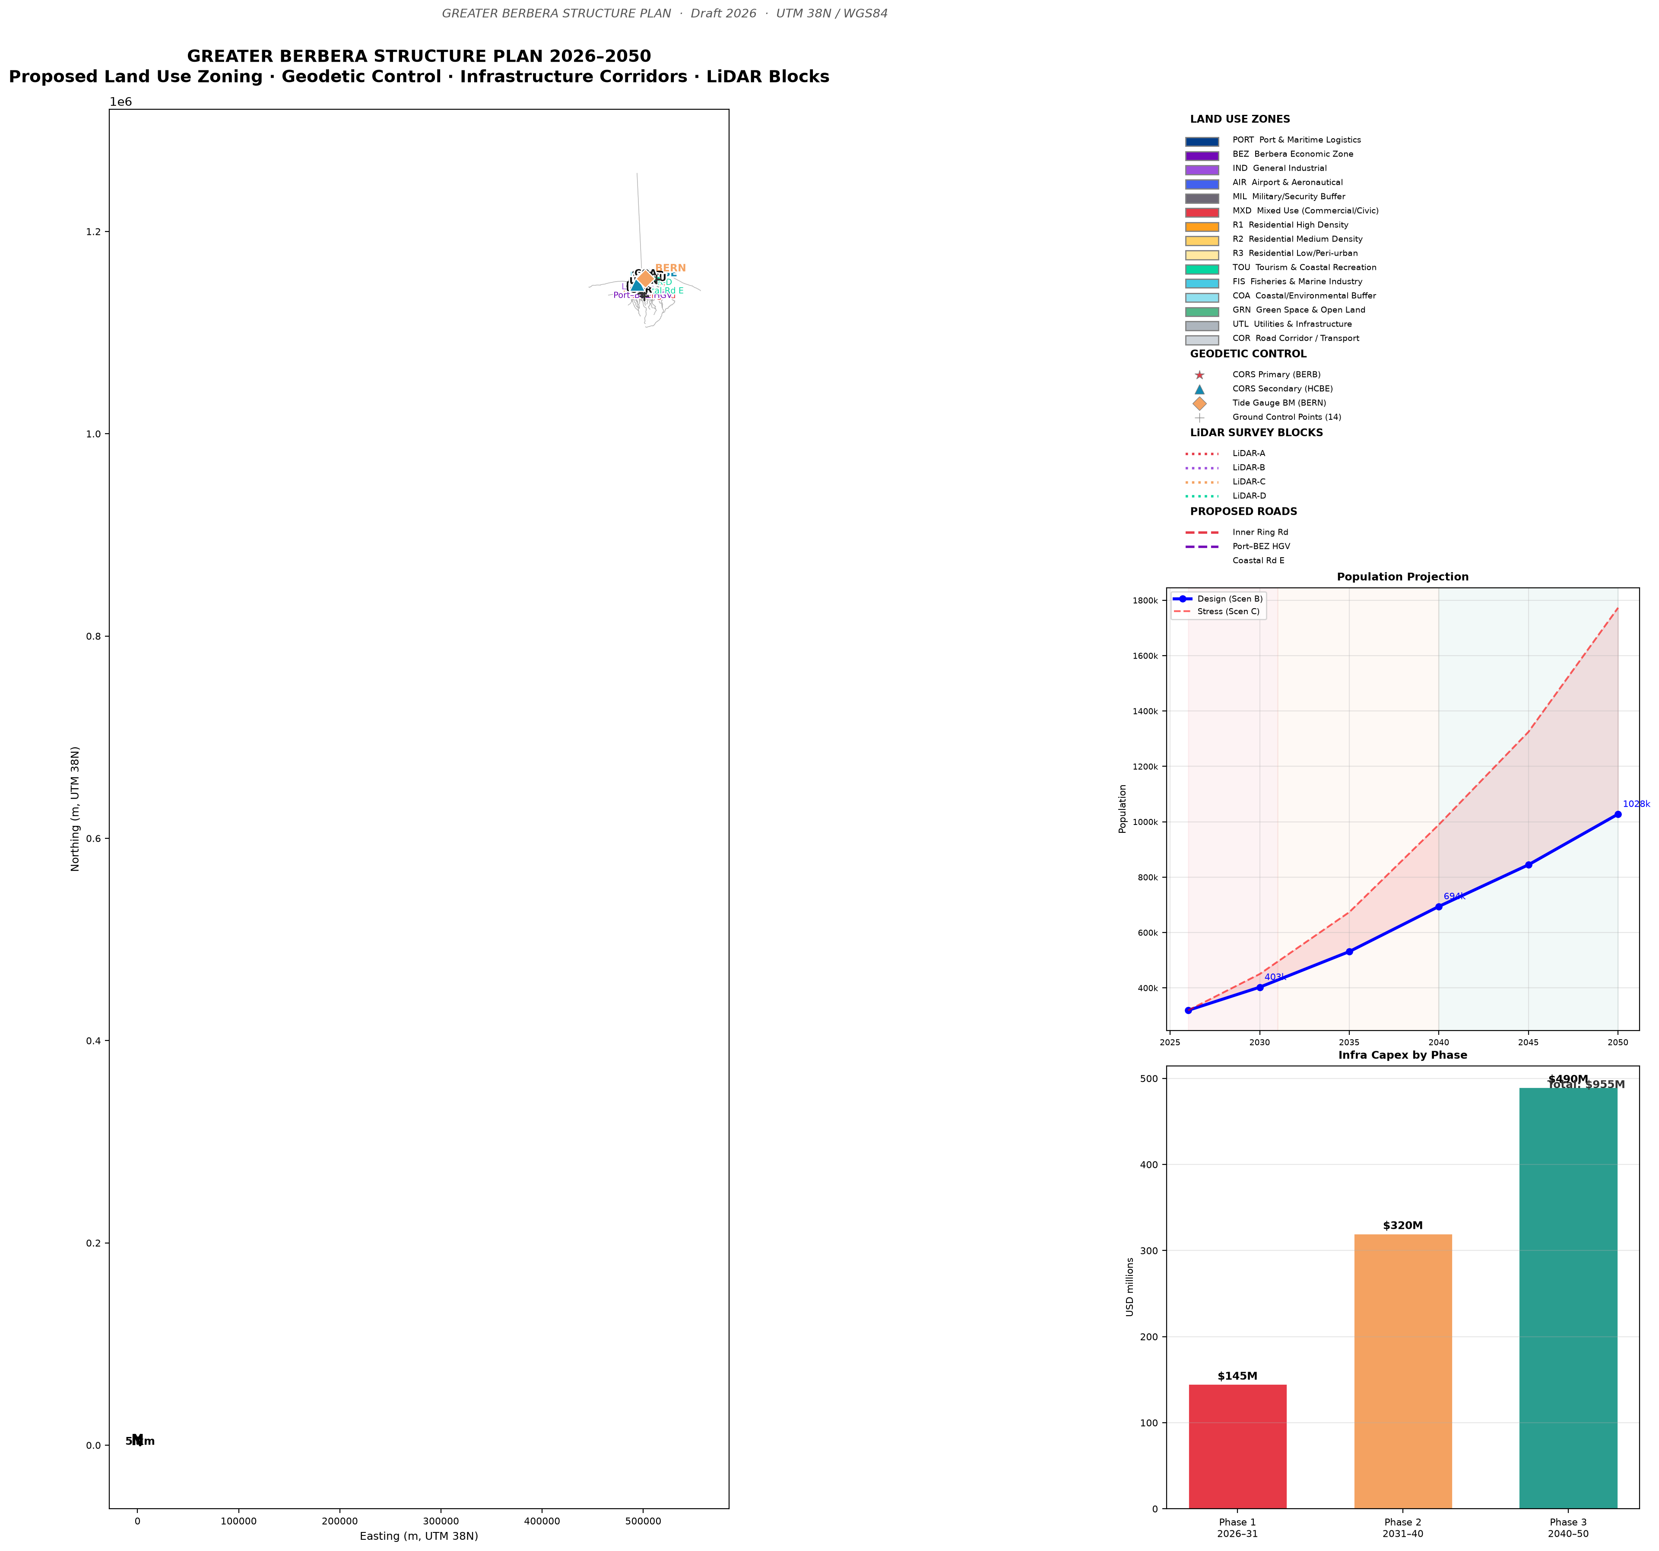
Berbera Urban Structure Plan
02 URBAN STRUCTURE
Zoning framework · Land use · Growth corridors
BERBERA URBAN ZONES — SCHEMATIC
DESIGN PRINCIPLES
Gulf of Aden coastline
Climate-responsive: shade, ventilation, solar orientation
Walkable: no plot >500m from a public green space
Heritage-sensitive: Old Town overlay preserves scale + character
Flood-resilient: +1m freeboard on coastal edge (IPCC AR6)
Mixed-income: 20% affordable housing quota in all new zones
Z1 · WATERFRONT PROMENADE & TOURISM
hospitality, reefer, heritage
Z2 · OLD TOWN CONSERVATION
max 2 floors, heritage overlay
Z3 · MIXED-USE CENTRE
commercial, retail, civic (max FAR 2.5)
Z4 · RESIDENTIAL LOW-DENSITY
PLAN COVERAGE AREAS
compound housing, 1–2 floors
Z5 · RESIDENTIAL MEDIUM
Berbera urban core
2,840 ha
apartments, max 5 floors, green courts
Port & BEZ
1,207 ha
Z6 · BEZ INDUSTRIAL BUFFER
logistics, light industry, setback 100m
Urban growth reserve
4,200 ha
Z7 · URBAN GROWTH RESERVE
Green buffer / coastal
680 ha
future phases 2–3, controlled release
TOTAL planning area
8,927 ha
Structure plan covers Notebooks NB03 (Urban Design) · NB05 (Zoning) · NB08 (Structure Plan)

Slide 5
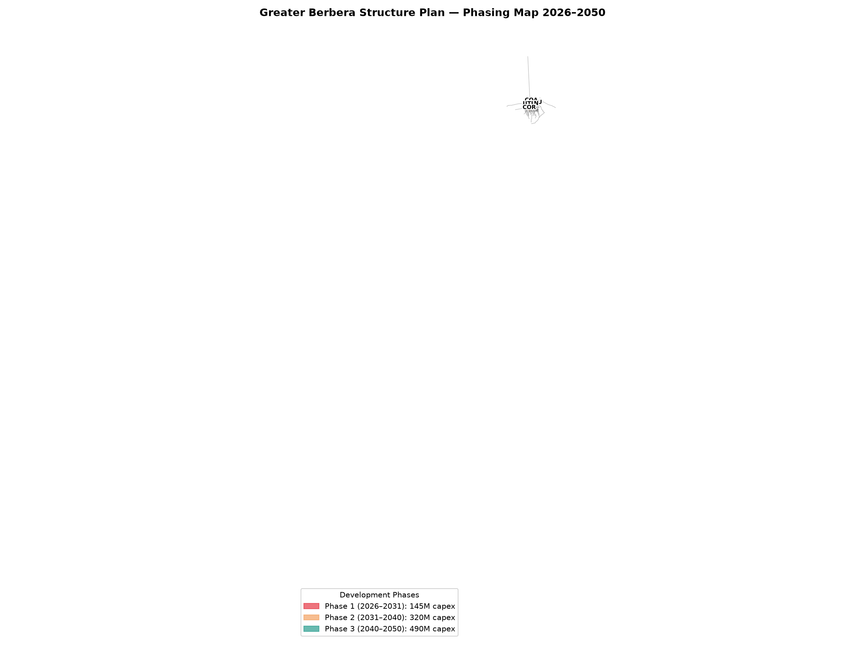
Phase 1: Neighbourhood Infrastructure
02 PHASE 1 QUICK WINS
2026–2030 · USD 1.05B total · What citizens will experience first
2026 Beautification begins
2027 First water connections
2028 Solar grid live
2029 BEZ Phase 1 opens
2030 Old Town complete
💧 Water in every home
☀ Power on all day
🌊 A seafront to be proud of
🏛 Old Town restored
🏗 Jobs from day one
By end 2027, every household in Berbera urban area has 24-hour piped water.
Clean, affordable, metered. No more water trucks.
USD 0.55/m³ — 90% cheaper than trucked water today.
By end 2028, Berbera runs on 100% solar electricity.
No more generator noise. No more load-shedding.
345 MW Phase 1 solar covers SWRO + city + industrial.
By end 2027, the Gulf of Aden waterfront is transformed.
3.2 km promenade, cafés, fishing jetties, night lighting.
The face of Berbera to the world.
Heritage facades, pedestrian streets, covered markets.
Berbera's history becomes a tourism asset.
Direct revenue: USD 10M/yr tourism target by 2030.
1,200 construction jobs during beautification phase.
5,000 BEZ jobs by 2029. 15,000 direct by Phase 2.
Local procurement mandate: 60% of contracts local.

Slide 6
02 URBAN VISION
BERBERA WATERFRONT — 2030 VISION
The Gulf of Aden is the greatest public asset Berbera owns.
Heritage
Mosque
Community
Park
Cultural
Centre
Café
Pavilion
Night
Market
Hotel
Terrace
Port
Gateway
Fishing
Jetty
3.2 km PROMENADE — paved, lit, planted
GULF OF ADEN
Promenade (3.2 km) · Heritage Old Town · Fishing Jetties · Night Market · Cultural Centre · Tourist Hotel (PPP) · Solar Street Lighting
Investment: USD 4.2M promenade + USD 3.1M Old Town · Returns: USD 10M/yr tourism revenue by 2030 · 1,200 construction jobs

Slide 7
Berbera–Sheikh–Burco Corridor
03 THE CORRIDOR
The urban transformation connects to a 320 km economic spine
The beautified town is the anchor. The corridor is the engine.
CORRIDOR SCHEMATIC
WHAT THE CORRIDOR DELIVERS
SHEIKH
↑ Agriculture
80,000 ha
Water for a growing city
BURCO
250k pop
The Berbera SWRO plant + highland dam feeds 694,000 people by 2045.
The 320 km pipeline crosses the escarpment and supplies Burco.
BERBERA
↑ Port, SWRO
BEZ, City
320 km pipeline
↑ 1,550 m
Food security for the Gulf
Sea
Sheikh's 1,550m altitude + irrigation from the pipeline = 80,000 ha
of high-value horticulture for direct export. USD 637M/yr.
Escarpment
Dam
Power along the spine
963 MW solar + wind powers every settlement from coast to highlands.
Fully renewable. LCOE USD 0.025/kWh.
Trade beyond Somaliland
Ethiopia is landlocked. The Berbera corridor is their port.
BEZ + DP World port = regional economic hub.

Slide 8
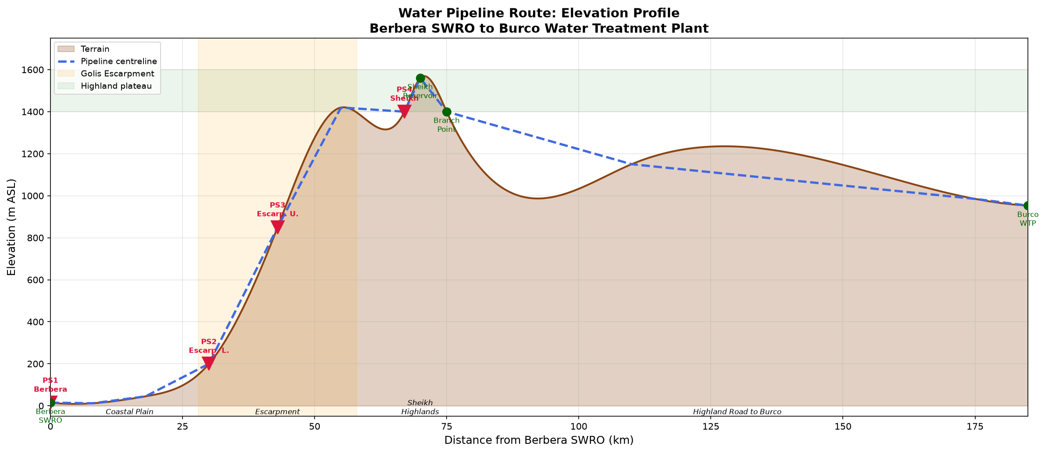
Water System: From Tap to Dam
03 INFRASTRUCTURE
SWRO desalination + Highland dam + 320 km pipeline
500,000
136
320
694,000
USD 0.55
m³/day SWRO
Mm³ (6.9 yr buffer)
km to Burco
by 2045
/m³ (vs USD 12 today)
Phase 3 supply
Dam storage
Pipeline length
Population served
Water tariff
PHASE 3 WATER BALANCE
PIPELINE ENGINEERING HIGHLIGHTS
SUPPLY
DN1200 pre-stressed concrete (coastal plain)
DN800–1000 steel PN63 (escarpment, 0–1,550m)
DN600 PE100 (Sheikh–Burco distribution)
4 booster pump stations (each 11 MW solar-powered)
Highest point: 1,550 m ASL · Surge pressure: 72–76 bar
Air valves every 800m · PRVs at escarpment break
Construction: 36-month programme · 2,800 workers peak
OPEX: USD 8M/yr energy (solar self-generation)
⚠ Hydrological ToR not yet issued — dam MAR is modelled
Commission stream gauging immediately (critical path)
SWRO desalination
182.5 Mm³/yr
Highland dam inflow
62.4 Mm³/yr
Total supply
244.9 Mm³/yr
DEMAND
Berbera urban
29.2 Mm³/yr
Sheikh + agriculture
138.7 Mm³/yr
Burco extension
14.6 Mm³/yr
Industrial/BEZ
40.2 Mm³/yr
Total demand
222.7 Mm³/yr
Annual surplus
+22.2 Mm³/yr ✓

Slide 9
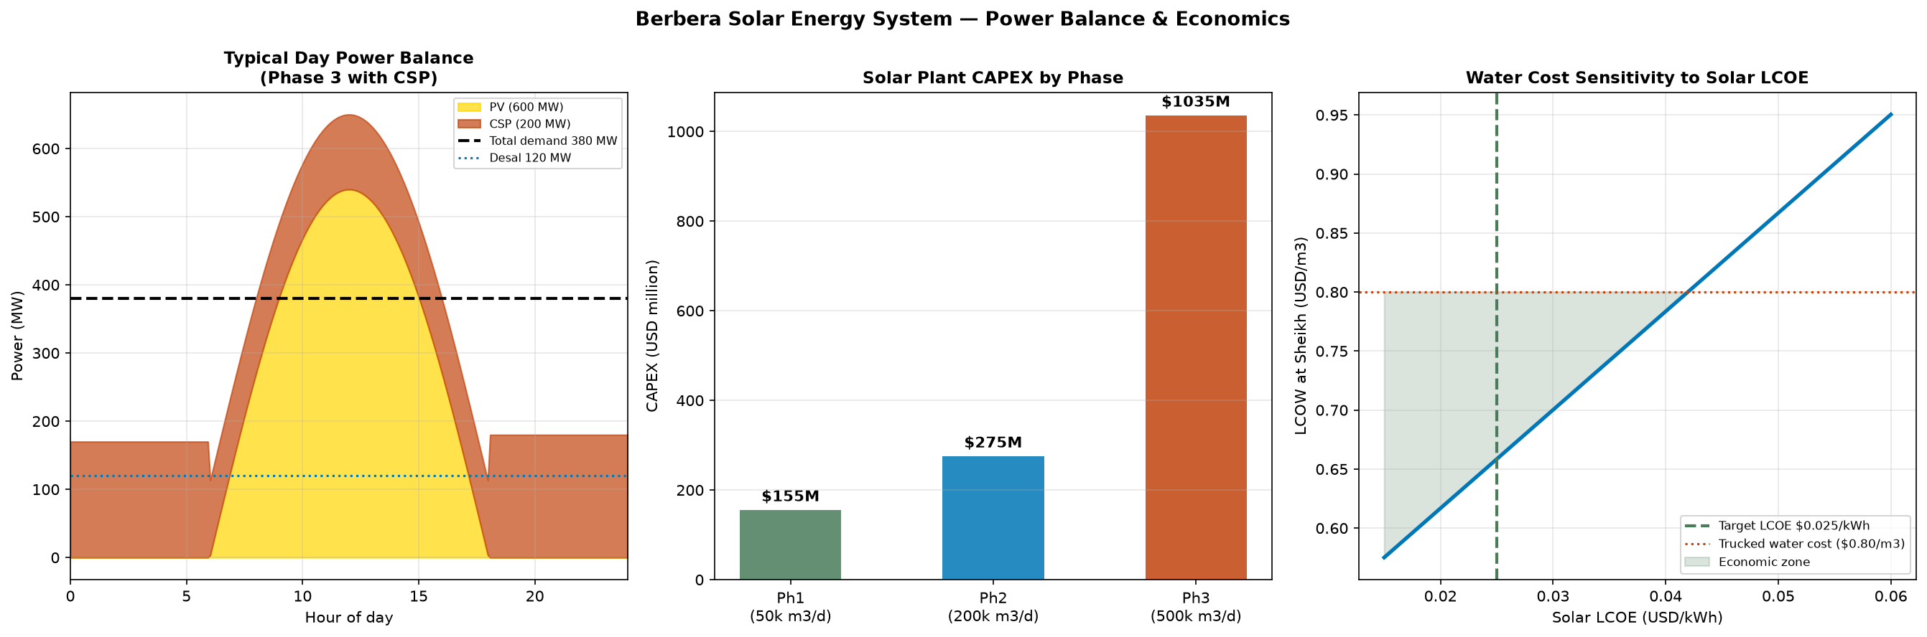
Renewable Energy System
03 INFRASTRUCTURE
963 MW Phase 3 · Solar PV + CSP + Wind · LCOE USD 0.025/kWh
963
2,100
6.4
1.45
Self-
powered
MW total
GWh/year
kWh/m²/day
Mt/year
solar covers SWRO
Installed (Ph3)
Annual output
Solar GHI
CO₂ avoided
SWRO energy
ENERGY BUILD-OUT BY PHASE
pvlib validated: 6.4 kWh/m²/day at 10.4° lat tilt
Optimal tilt = latitude — solar noons year-round
Phase 1: SWRO energy demand = 1,750 MWh/day
345 MW solar @ 6 hr/day = 2,070 MWh/day ✓
Phase 3 CSP adds 6-hour thermal storage
Enables 24-hour despatchable power
Wind (escarpment): 6.5 m/s · CF 0.38
Complementary to solar (reduces BESS)
Grid export Phase 3: 80 MW surplus
Revenue: USD 80M/yr at USD 0.11/kWh
Phase
Solar PV
CSP
BESS
Output
CAPEX
Ph1 2026–30
345 MW
—
2 hr
620 GWh/yr
USD 155M
Ph2 2031–35
611 MW
—
4 hr
1,100 GWh/yr
USD 275M cum.
Ph3 2036–40
744 MW
219 MW
6 hr
2,100 GWh/yr
USD 1,035M cum.

Slide 10
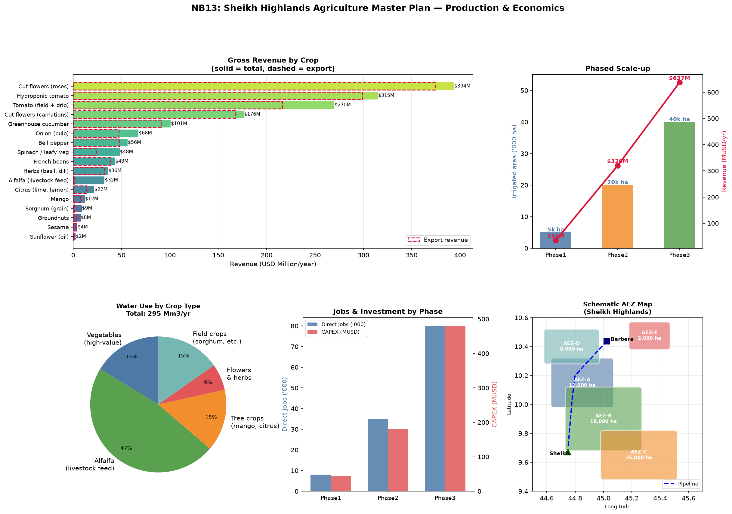
Sheikh Highland Agriculture
04 ECONOMIC ENGINE
USD 637M/yr exports · 80,000 direct jobs · Gulf food security
80,000
USD 637M
80,000
1,550m
Gulf in
3 days
hectares (Phase 3)
/year
Phase 3
ASL (cool, fertile)
reefer from Berbera Port
Agricultural area
Export revenue
Direct jobs
Elevation
Market
CROP PORTFOLIO — PHASE 3
Sheikh climate: 800mm/yr rainfall + 1,550m altitude
→ naturally cool for high-value horticulture
Irrigation: drip + sprinkler (85% efficiency)
Water source: SWRO pipeline + dam spate flows
Pykrige soil mapping identifies AEZ-A/B boundaries
AEZ-A (<2 dS/m ECe): premium horticulture
AEZ-B (2-4 dS/m): cereals, alfalfa, oil crops
Gulf food security: Saudi/UAE import >80% of food
Reefer shipping Berbera→UAE: 3 sailing days
⚠ Soil survey ToR not yet issued — AEZ boundaries
pending field validation
Crop
Area
Yield
Revenue/yr
Primary market
Horticulture
(tomato, pepper, onion)
20,000 ha
25 t/ha/yr
USD 180M
UAE/Saudi reefer
Mango & banana
(perennial orchard)
5,000 ha
20 t/ha/yr
USD 140M
Gulf premium
Alfalfa (livestock feed)
10,000 ha
18 t/ha/yr
USD 112M
Livestock + export
Grain & pulses
30,000 ha
3.5 t/ha/yr
USD 105M
Domestic + Burco
Sesame & oil crops
15,000 ha
1.2 t/ha/yr
USD 100M
Export oil
TOTAL
80,000 ha
—
USD 637M
—

Slide 11
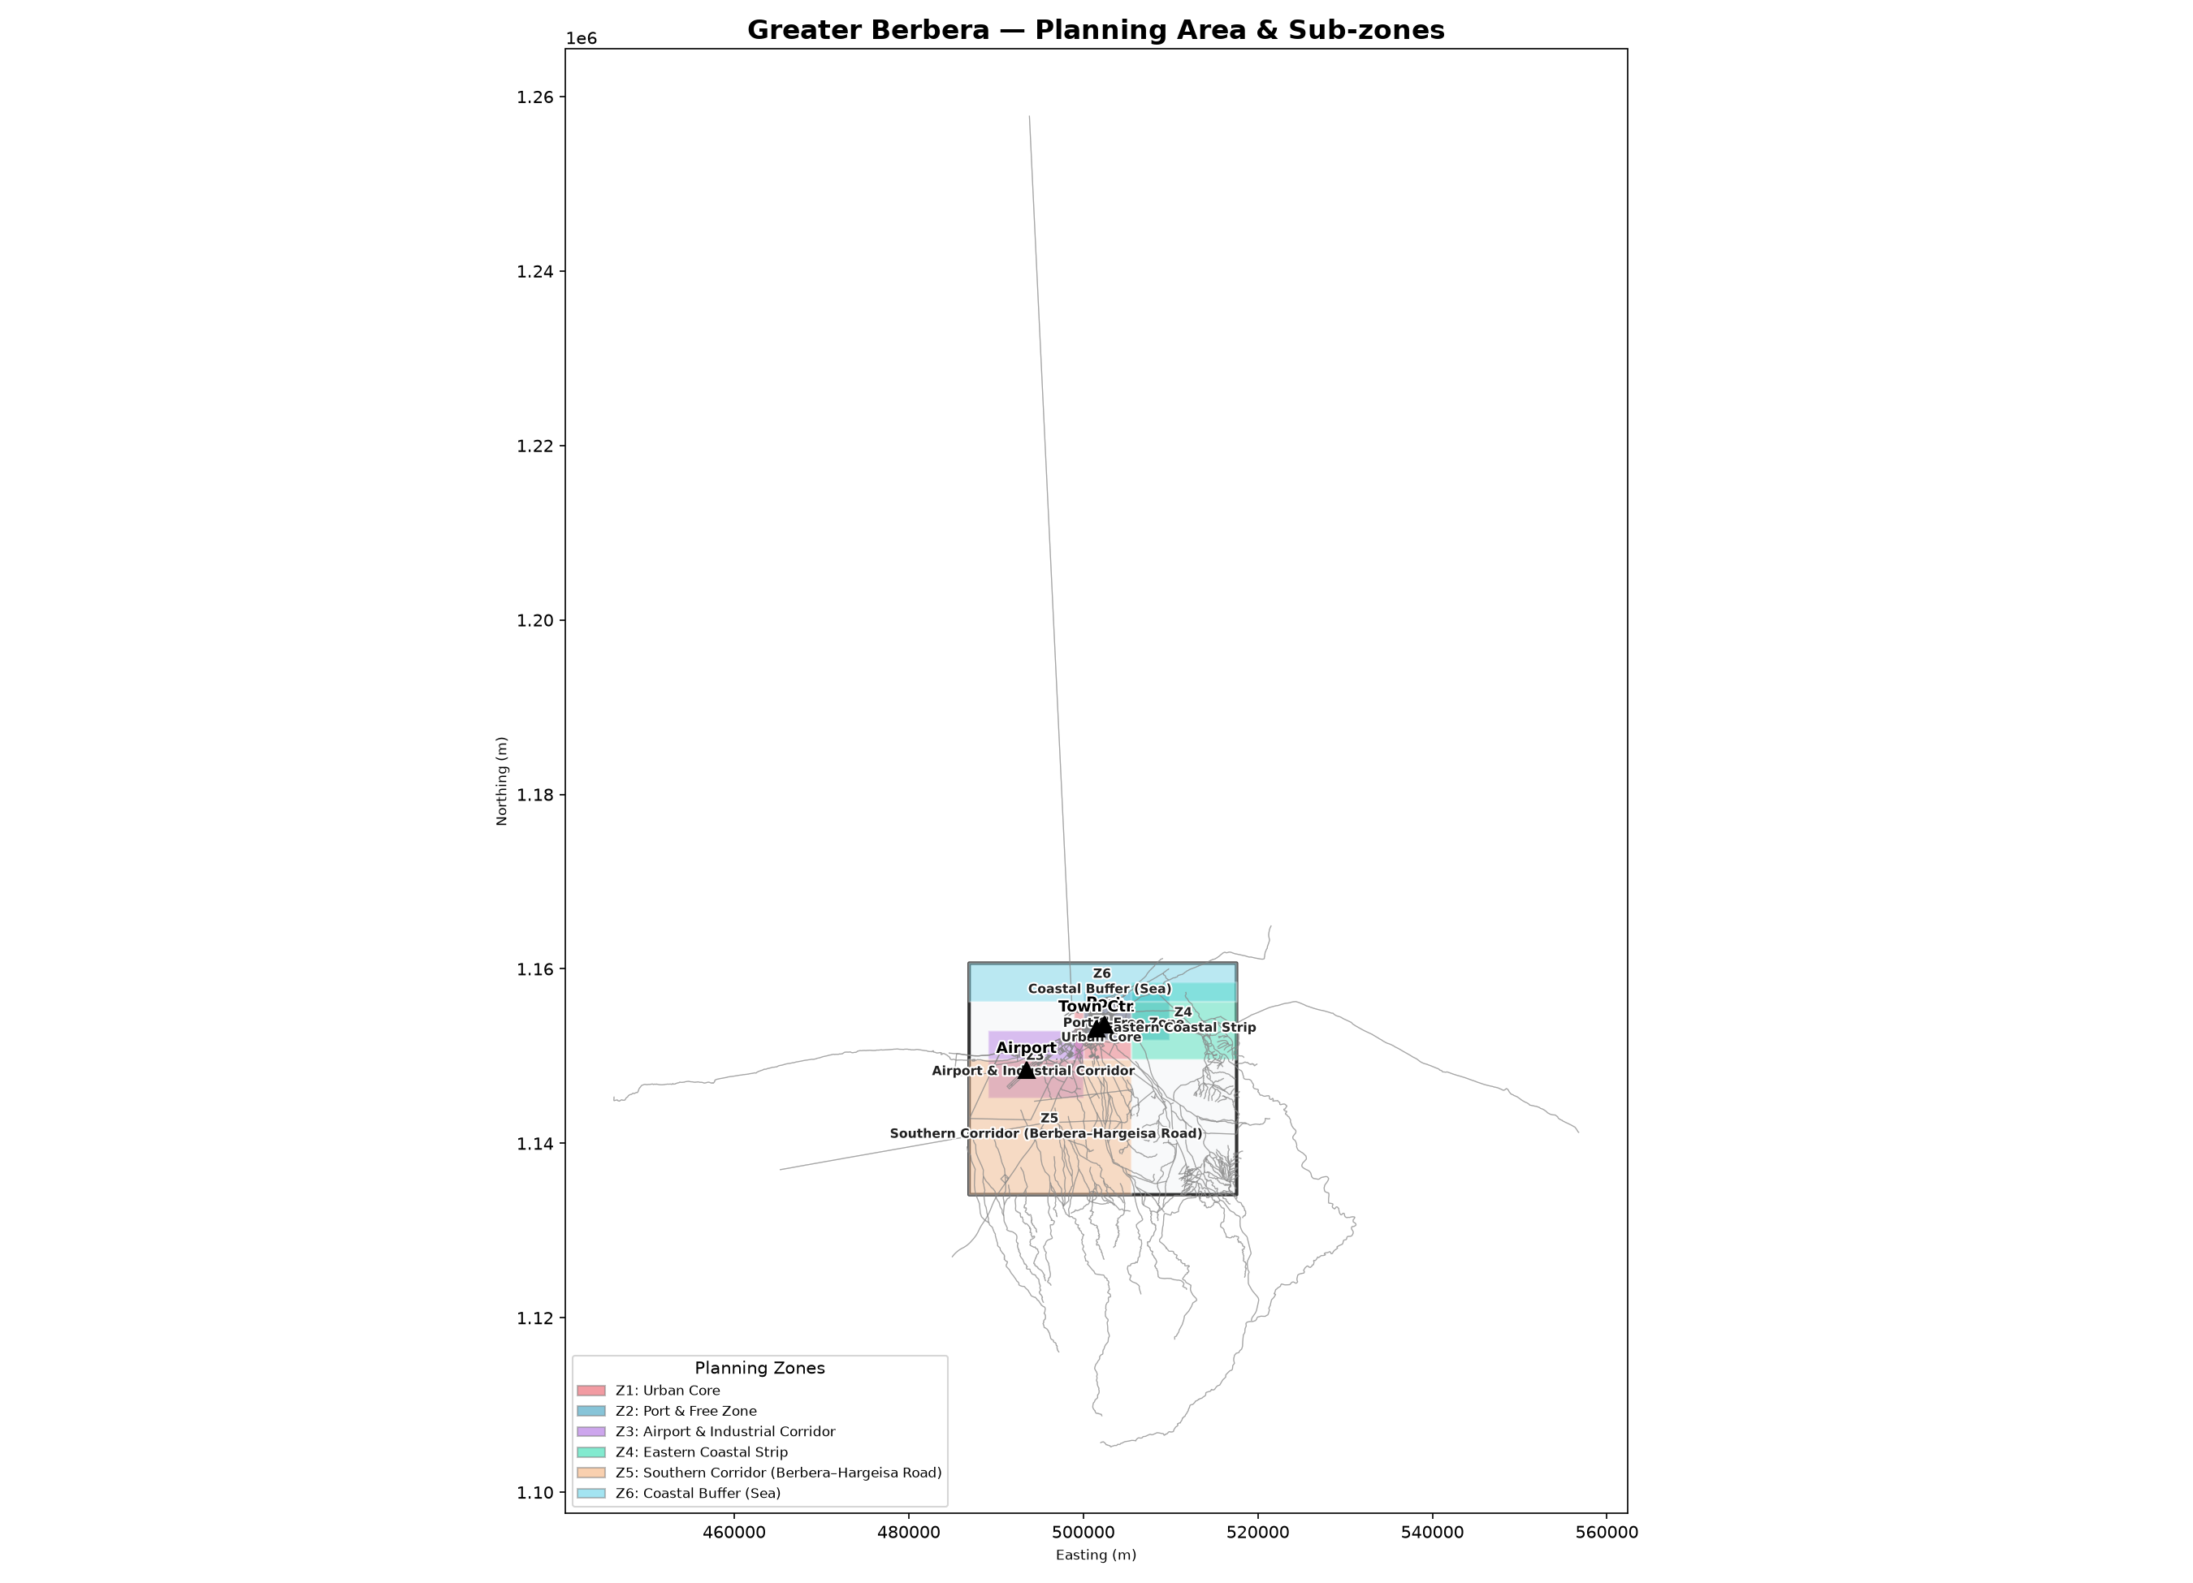
Port & Berbera Economic Zone
04 ECONOMIC ENGINE
DP World concession · BEZ 1,207 ha · Regional trade hub
BERBERA PORT — DP WORLD CONCESSION
BERBERA ECONOMIC ZONE (BEZ)
DP World 30-year concession · Phase 2 expansion USD 400M
(private capital — no government contribution)
Gulf of Aden: 12% of global trade passes through
Ethiopia landlocked → Berbera is primary transit route
Reefer terminal: cold chain link for Sheikh exports
Phase 2 target: 8M TEU equivalent/year throughput
Port revenue (Govt share): USD 55M/yr at Phase 3
New: port access boulevard (flagship beautification)
First impression for every ship crew, every cargo agent
Phase 1
2026–30
1,207 ha
5,000 jobs
Industrial, logistics, food processing
Phase 2
2031–35
+1,800 ha
12,000 jobs
Light manufacturing, tech parks
Phase 3
2036–40
+3,000 ha
25,000 jobs
Full SEZ, chemical, maritime services
Port Phase 2: USD 400M from DP World balance sheet.
No fiscal exposure for Somaliland government.
Power: dedicated solar microgrid (100% renewable)
Water: industrial allocation from SWRO Phase 1
Governance: BEZ Authority — new legislation required
BEZ revenue (fees + fiscal): USD 120M/yr Phase 3

Slide 12
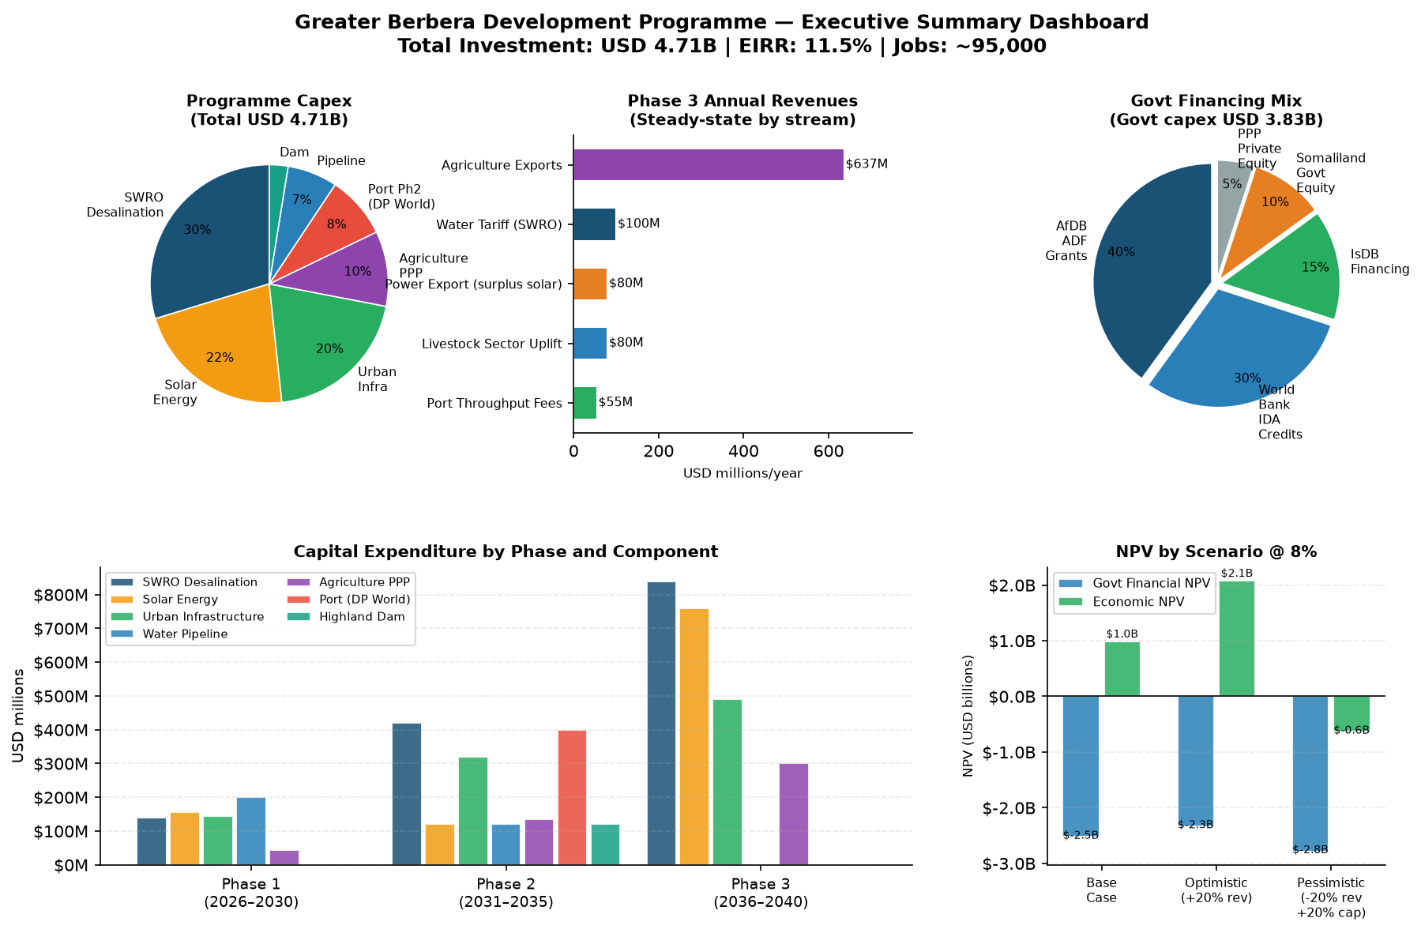
The Greater Picture: Integrated Financial Summary
05 THE GREATER PICTURE
USD 1.64B government/DFI programme · EIRR >12% · 35-year horizon
USD 1.05B
USD 1.43B
USD 2.17B
USD 1.5B
>12%
2026–2030
2031–2035
2036–2040
/year at maturity
AfDB 8% threshold
Phase 1 investment
Phase 2 investment
Phase 3 investment
Phase 3 revenue
Programme EIRR
REVENUE STREAMS (USD M/yr)
FINANCING MIX — GOVT/DFI (USD 1.64B)
Stream
Ph1
Ph2
Ph3
AfDB ADF (40%)
Agriculture exports
35
320
637
USD 656M
0%, 40yr, 10yr grace · Somaliland ADF-eligible
BEZ/SEZ fees + fiscal
15
45
120
World Bank IDA (30%)
Port throughput (govt)
22
35
55
USD 492M
0.75%, 25yr, 5yr grace
Water tariff
10
40
100
IsDB (15%)
USD 246M
2.0%, 20yr · Development funding
Power export
—
20
80
Somaliland Govt (10%)
Livestock & other agri
—
58
80
USD 164M
Land + in-kind contribution
Tourism & real estate
10
35
80
PPP / Blended (5%)
TOTAL
92
553
1,152
USD 82M
Co-investment + guarantees
Private/PPP share: USD 3.01B (port, solar IPP, BEZ operators) — not included in govt programme above

Slide 13
Key Risks & Mitigations
05 RISK & PATHWAY
Top 5 risks · All identified · All manageable
R01
Geopolitical
HIGH
Recognition / stability risk
Mitigation: AfDB country risk envelope · phased disbursement · MIGA political risk insurance
R02
Hydrological
HIGH
Dam MAR unvalidated — no gauging data yet
Mitigation: Commission 2-yr gauging immediately (ToR A) · design to Q90 · dam stores 6.9yr supply
R03
Construction
MEDIUM
CAPEX overrun: remote site + Red Sea logistics
Mitigation: Fixed-price EPC · 20% contingency in model · advance procurement of long-lead items
R04
Fiduciary
MEDIUM
Counterpart capacity (USD 164M contribution)
Mitigation: Deferred counterpart schedule · AfDB grant share to 45% · escrow facility
R05
Institutional
HIGH
No PPU yet — no single DFI counterpart in place
Mitigation: Cabinet decree within 90 days · AfDB TA facility to fund PPU staff and management
Scenario analysis: pessimistic case (CAPEX +20%, revenue –20%, 2yr delay) still shows positive NPV at 8% discount rate.

Slide 14
Pathway to DFI Financing
05 DFI PATHWAY
Q1 2027 → Q4 2028 AfDB/IDA Board Approval
Q1 2027
Q2 2027
Q3 2027
Q4 2027
Q1 2028
Q3 2028
Q4 2028
Q1 2029
Q4 2030
Commission
surveys
Submit AfDB
Concept Note
AfDB pre-
appraisal mission
PPU
established
ESIA draft
complete
Full feasibility
report
Board
Approval
Loan
effective
Phase 1
commissions
DFI INSTRUMENTS & KEY REQUIREMENTS
AfDB ADF
USD 656M
World Bank IDA
USD 492M
IsDB
USD 246M
Conditions for all
DFI approval
ADF-only country status confirmed
Concept Note → Quality at Entry review
ESIA to AfDB ESAP standard
Fiduciary assessment of MoF
IDA eligibility — Somaliland included
ESCP (Env & Social Commitment Plan)
Procurement per WB Regs for IPF
Parallel finance coordination with AfDB
IsDB member state (Somalia/Somaliland)
Istisna'a or Ijara instrument
Islamic finance structure review
HSBA (health, safety, biodiversity audit)
PPU in place with qualified staff
ESIA complete + public consultation
Financial model audited by DFI
Government counterpart confirmed
Full 15-notebook analysis and data available at 🌐 berbera.dev

Slide 15
90-Day Immediate Actions
05 90-DAY ACTIONS
What must happen now to keep the programme on track
A01
Issue hydrological
study ToR
USD 850k
A02
Issue UAV survey
ToR
USD 380k
Week 1–2 · Lead: Ministry of Water Resources
Week 1–3 · Lead: Municipal Planning Dept
Stream gauging at Sheikh for dam MAR validation. 18-month critical path item.
5cm GSD ortho + DTM of full corridor. 6-month programme. Feeds NB01–NB14.
A03
Commission ESIA
scoping
USD 2.5M
A04
Submit AfDB
Concept Note
Month 1–3 · Lead: EPA + Ministry of Finance
Month 2–3 · Lead: Ministry of Finance
Longest-lead item: 18 months total. WB ESF & AfDB ESAP standards.
Opens DFI pipeline. Triggers AfDB PPF preparation grant for feasibility funding.
A05
Geotechnical
investigation ToR
USD 1.2M
A06
Cabinet decree:
Establish PPU
Month 1–2 · Lead: Ministry of Water Resources
Month 2–3 · Lead: Cabinet
Dam site foundation survey. ICOLD Class II dam compliance. Site characterisation.
Project Preparation Unit at MoF. AfDB TA will fund staff costs. Single DFI counterpart.
Total 90-day survey budget: ~USD 5M · Request AfDB PPF grant alongside Concept Note (no govt cash required)

Slide 16
WHAT WE ARE ASKING FOR
1
Begin the beautification — this quarter
Authorise the waterfront promenade RFP and street tree programme.
USD 5.8M · visible within 12 months · 1,200 jobs · signals intent to investors.
2
Issue four critical survey RFPs immediately
Hydrological study, UAV survey, geotechnical investigation, ESIA scoping.
Total USD 5M. These are on the critical path for 2028 DFI board approval.
3
Cabinet mandate: establish the Berbera Development Authority
The legal framework for signing DFI agreements, issuing RFPs, managing land.
The single most important institutional step. Can be a decree, not legislation.
4
Ministerial letter of engagement to AfDB Eastern Africa Hub
Opens formal DFI dialogue. Enables AfDB PPF grant to fund feasibility work.
No budget from Somaliland — AfDB finances the preparation.
From a single promenade to a USD 1.5 billion programme — this is how it begins.

Slide 17
GREATER BERBERA
One promenade.
One pipeline.
One programme.
USD 20M
USD 1.64B
95,000
694,000
100%
USD 637M
Immediate
beautification
Govt/DFI
programme
Direct jobs
Phase 3
People with
clean water
Renewable
energy
Agricultural
exports/yr
Berbera Physical Planning Team · Pre-Feasibility Level · October 2026
🌐 berbera.dev

